Slide 1
Experimental Physics and Industrial Control System Overview
Kay Kasemir
July 2026

Slide 2

What EPICS looks like
Network Diagram, ~1990
Network Diagram, ~2019
Block Diagram, ca. 2000

Slide 3
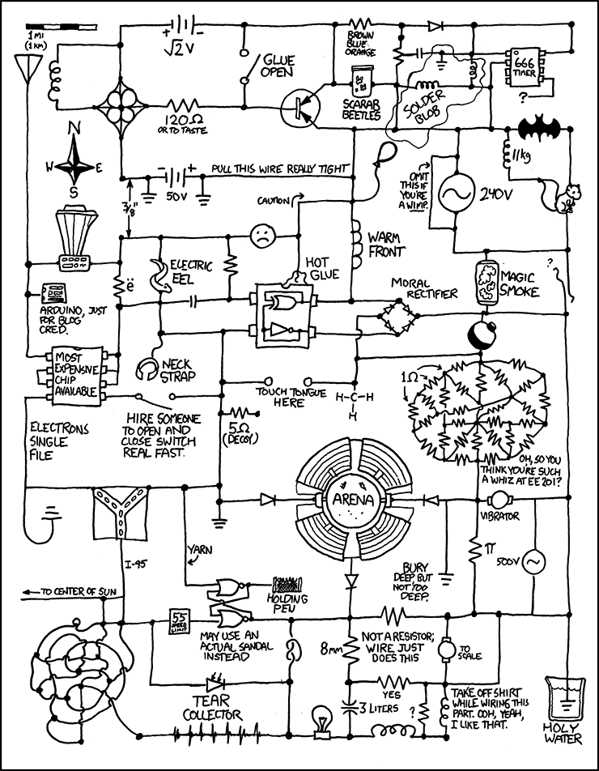
Elec.Eng. Perspective
Oracle
http://xkcd.com/730/

Slide 4
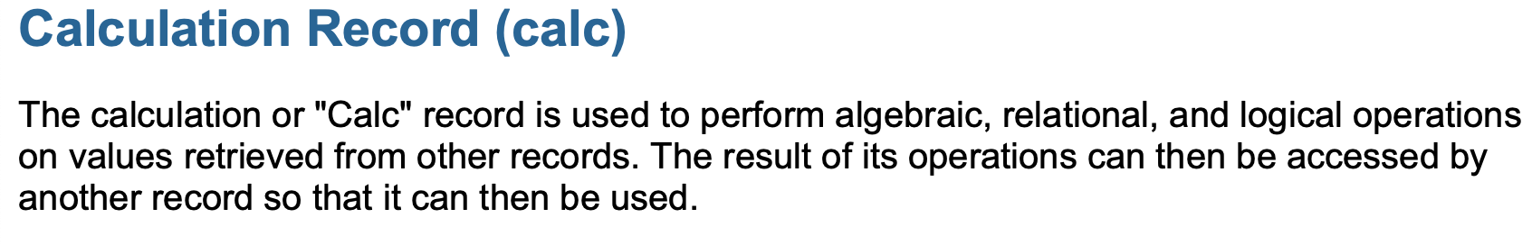
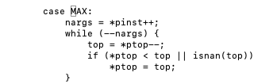
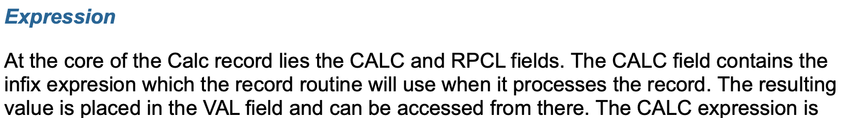
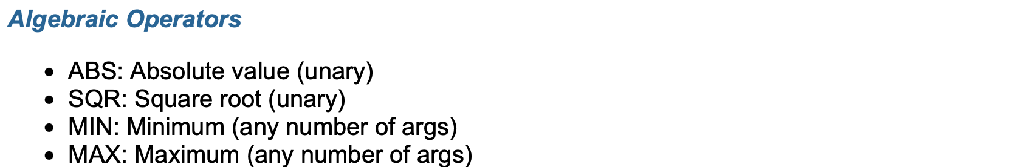

Experimental Physics and Industrial Control System
Easy, Practical and Intuitive Control System!
Free*, open-source, with documentation, mailing lists, …
https://epics.anl.gov/base/R7-0/6-docs/calcRecord.html
base/…../calc/calcPerform.c
.. as in beer as well as speech
No royalties
Nothing hidden
Modify as you wish

Slide 5
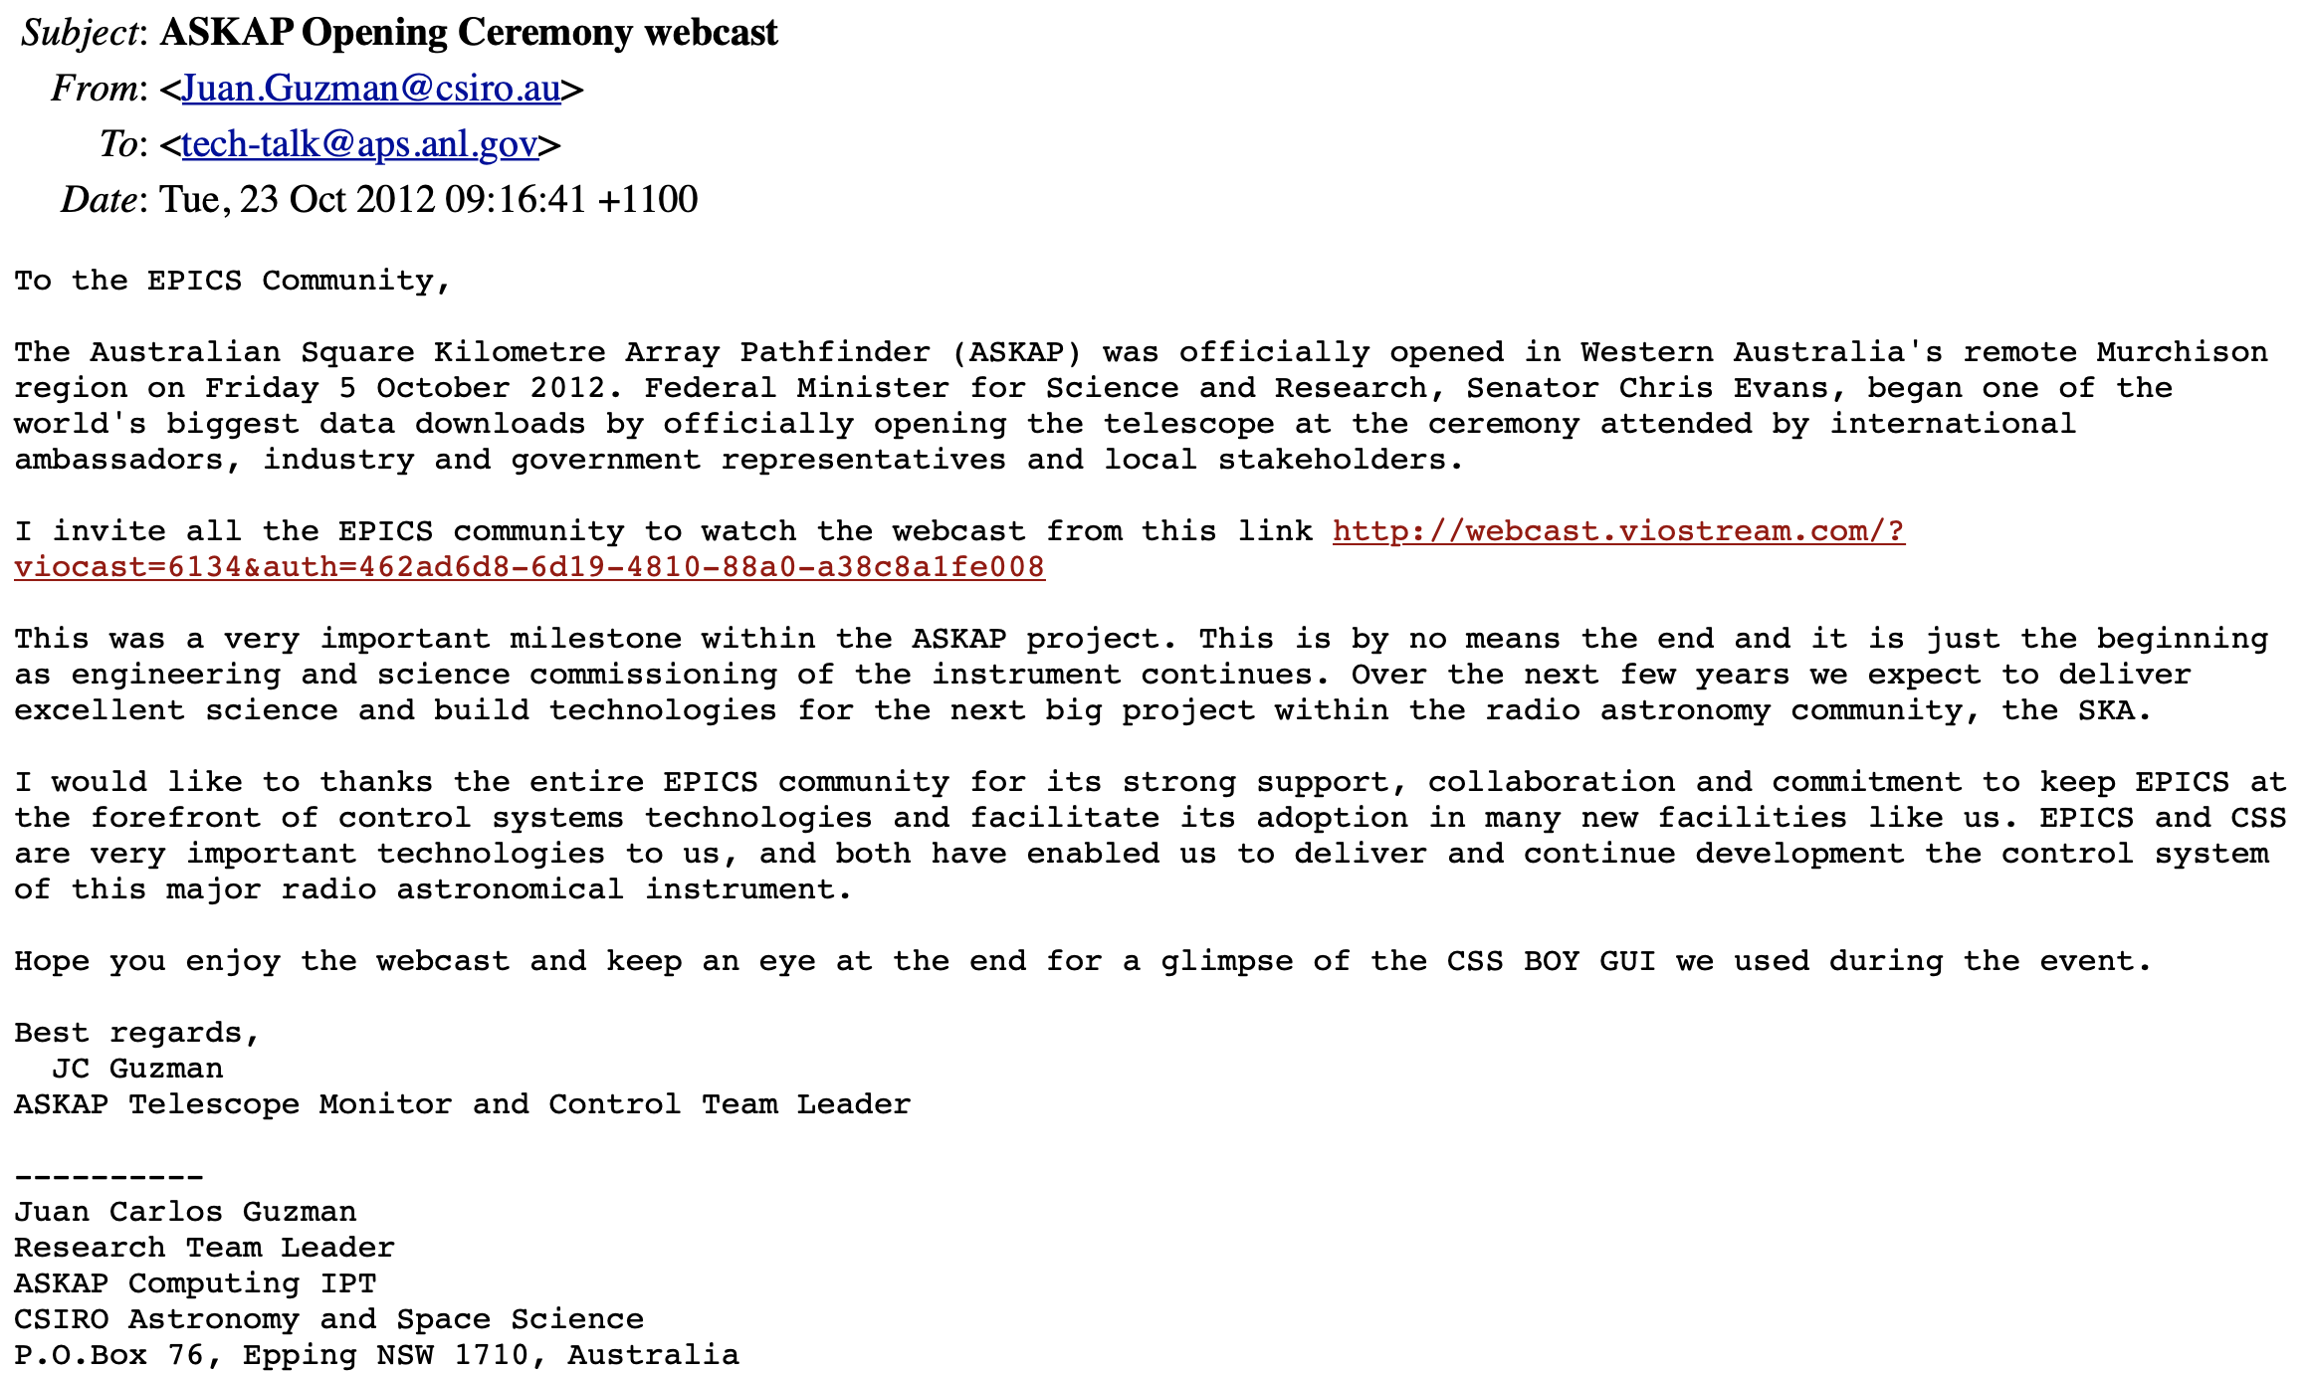
Antipodean Example

Slide 6
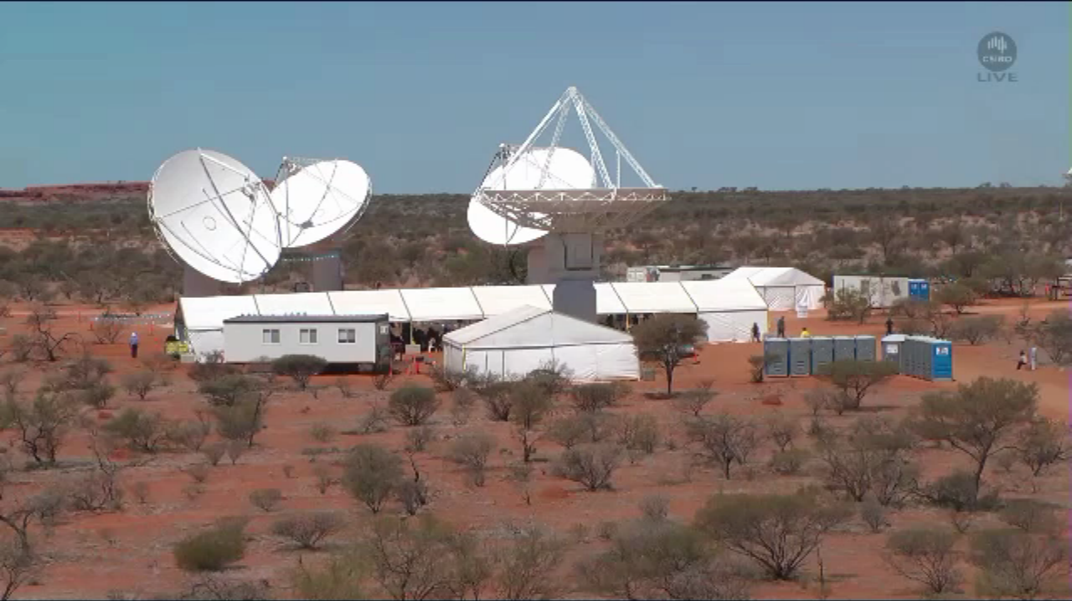
Australian Square Kilometre Array Pathfinder
(ASKAP), Oct. 5, 2012
Juan Guzman, http://www.aps.anl.gov/epics/tech-talk/2012/msg02113.php

Slide 7
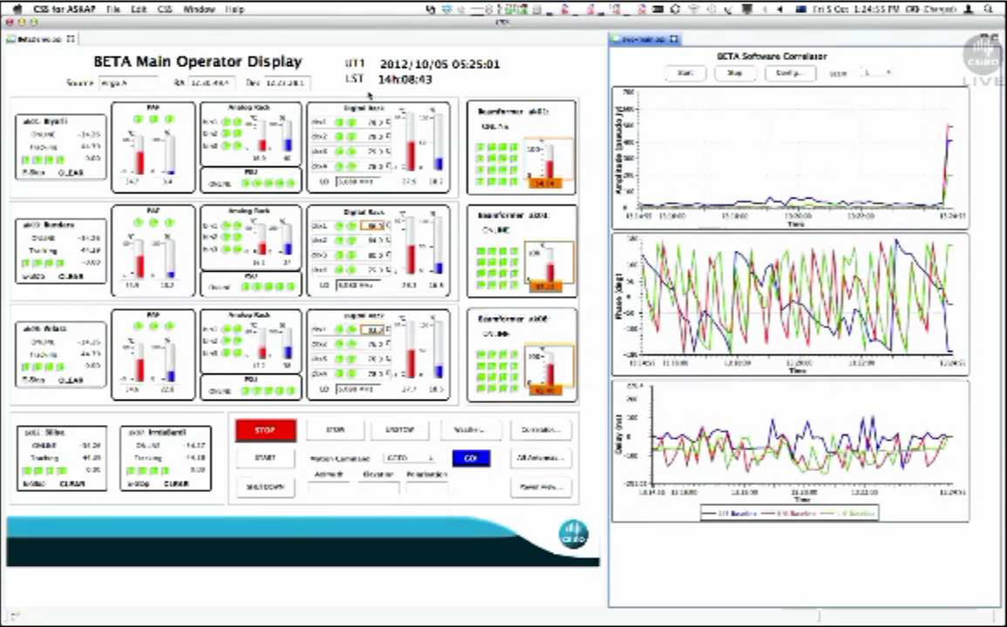
ASKAP User Interface
Juan Guzman, http://www.aps.anl.gov/epics/tech-talk/2012/msg02113.php

Slide 8
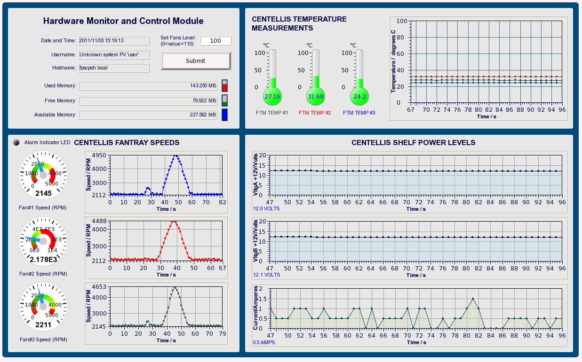
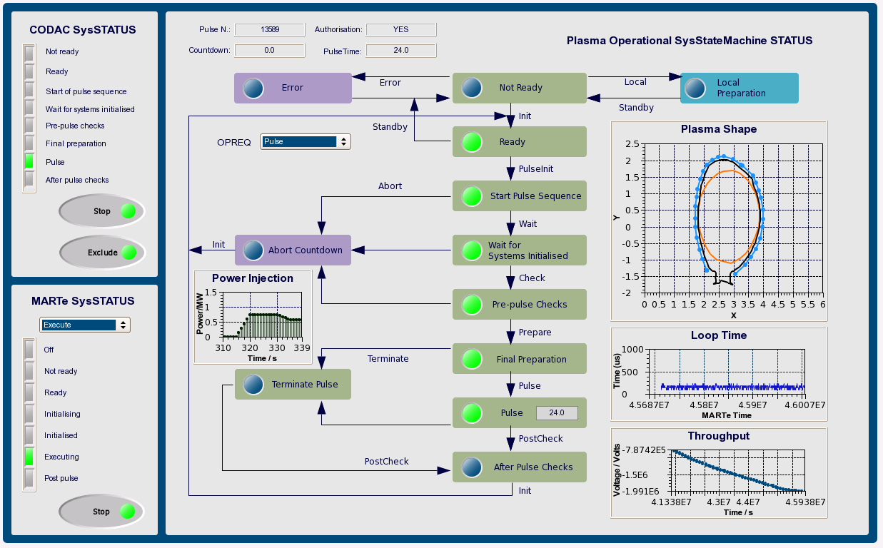
ITER
ITER-FPSC-vBetaVersionPanelsOPI-UserManual.doc, Nadine Utzel, 2011

Slide 9
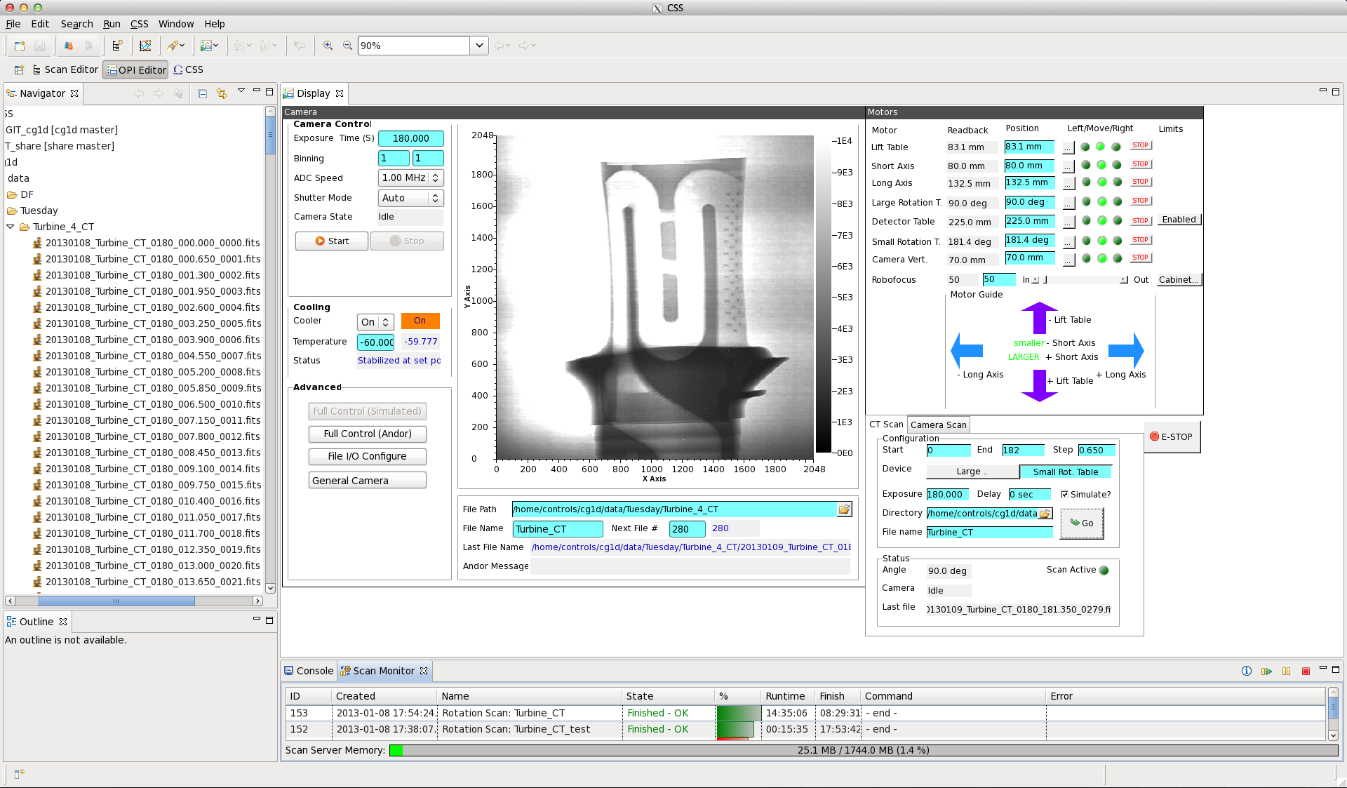
ORNL HFIR CG-1D
First EPICS/CSS operation with beam, 2013

Slide 10
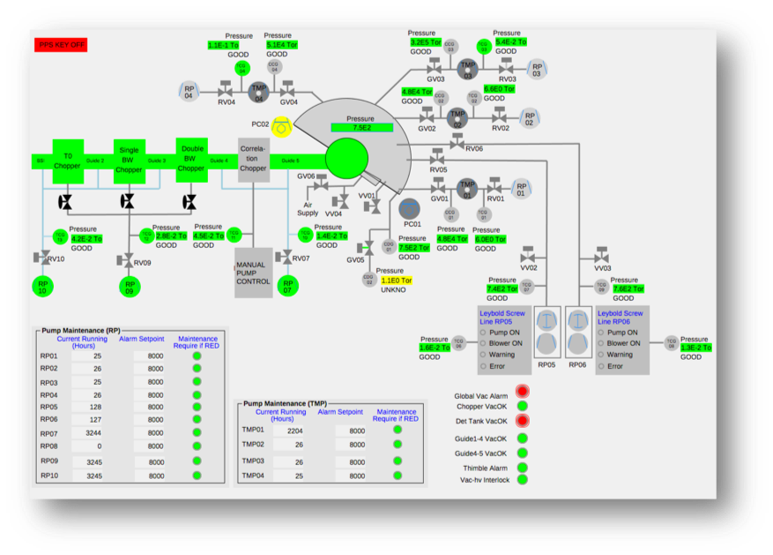
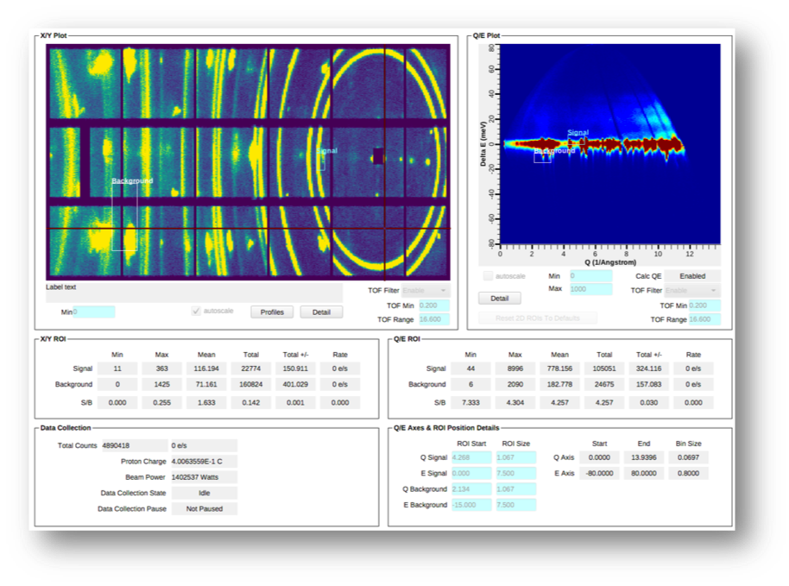
ORNL SNS Beam Lines

Slide 11
EPICS is not…
One product that you
Install
Run
Done!

Slide 12
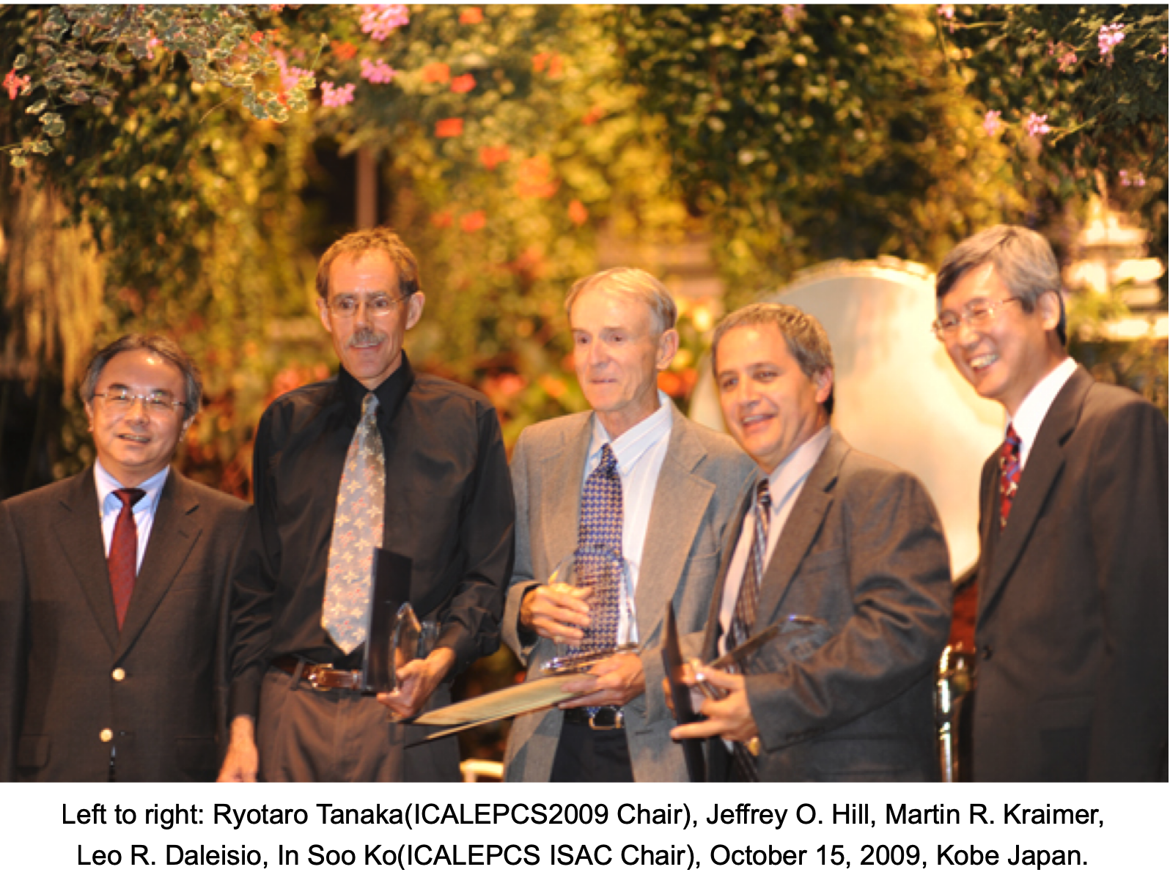
EPICS is a Collaboration
Lifetime Achievement Award
~1989: Started between
  LANL Ground Test Accelerator
  ANL Advanced Photon Source
Until 2004: License agreement required
  LANL registered >150
Now:
  SNS, ANL/APS, BNL, FRIB, SLAC, LANL, JLAB/CEBAF, LBNL, Fermilab D0, Keck & Gemini Telescopes … in the USA
  European Spallation Source in Sweden; Canadian Light Source; DESY, BESSY, .. in Germany; PSI/SLS in Switzerland; Ganil, SACLAY in France; Diamond Light Source and ISIS in England; KEK, J-Parc in Japan; IHEP in China; NSRRC in Taiwan; PLS in South Korea; Australian Synchroton, …
Yearly collaboration meetings
  One each in US and elsewhere
  Typically, >100 people
'Tech-Talk' email reflector usually provides responses within a few hours
  https://epics-controls.org
  Matrix-based chat

Slide 13
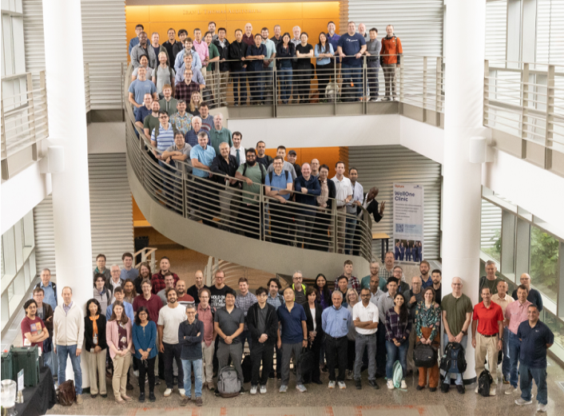
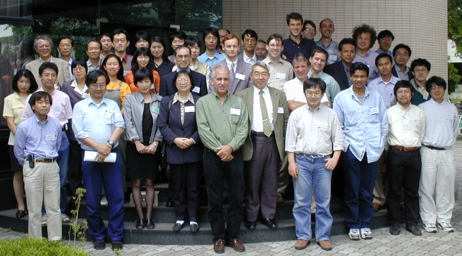
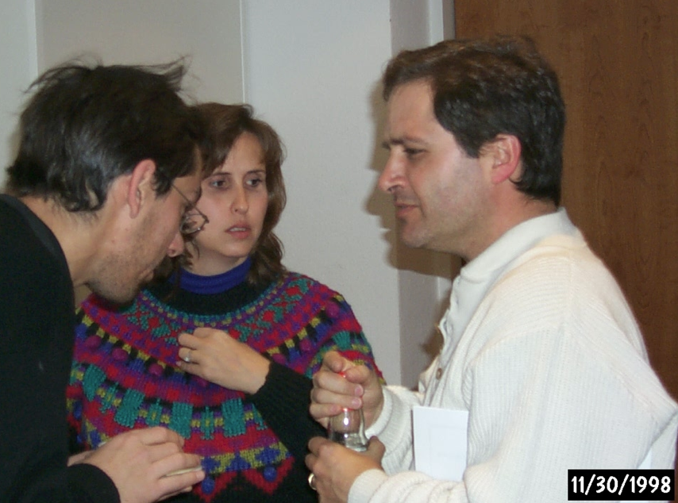
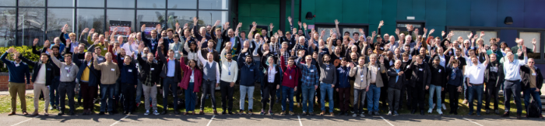
https://epics-controls.org Meetings
Chicago, 2018
Oak Ridge, 2016 & 2024
Tzukuba, 2000
Berlin, 1998
…,
Oxfordshire2025

Slide 14
EPICS is a Toolkit for distributed control systems
Front-end: “Input/Output Controller” (IOC)
Protocol: Channel Access (PV Access)
Clients: Operator displays, alarm system, …
Mostly Portable:
vxWorks, RTEMS, Linux, OS X, Windows

Slide 15
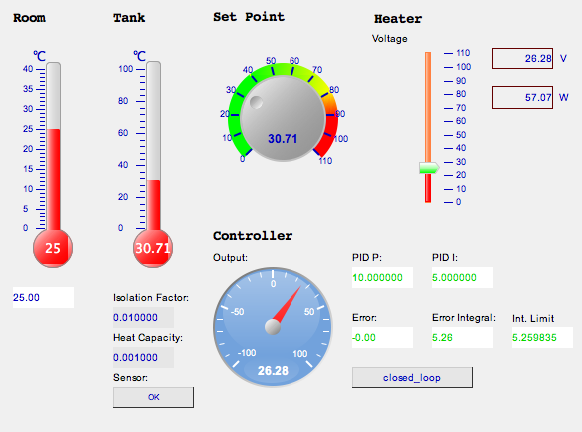
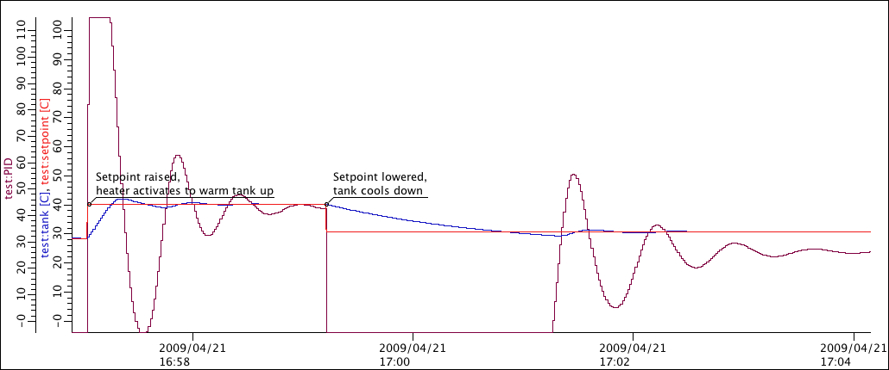

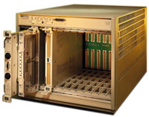
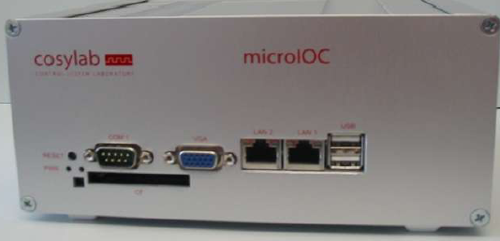
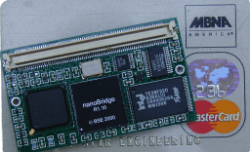
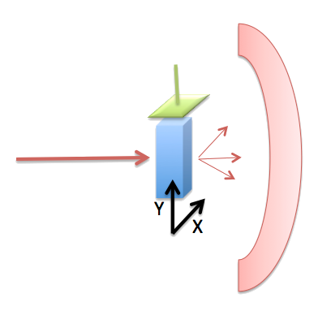
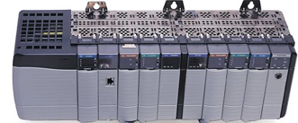

Distributed
Operator interface
Services: Archive, …
Front-end IOCs
I/O, PLCs, ..

Slide 16
What an IOC does
Runtime ‘Database’
  Executes records
Known set of ‘Records’
  Read analog value
  Write analog value
  Perform computation
  Control motor
Configuration
  SCAN=1 second
  INP=..what to read..
Serve all via Channel Access or PV Access

Slide 17


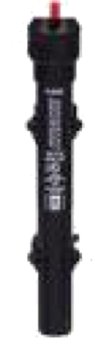
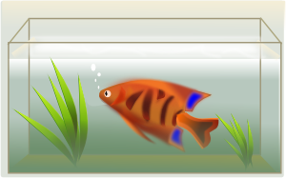

Example: Basic Temperature Control
  Task:
  Read temperature
  Open/close switch as needed
  Repeat
Software?

Slide 18
Simplistic Code
Sensor temp = connectToSensor(…);
Switch switch = connectToSwitch(…);
Loop:
if (temp.value() < 10)
switch.close();
else
switch.open();
sleep(1.0);

Slide 19
That basically works...
Temperature
Heater on, off, on, off, ...
Desired Temp.
Actual Temp.
Time

Slide 20
What we omitted
Error checking
Code comments
Smoothing of the temperature reading to filter noise
Send current temperature and switch state to network clients (operator display). With units
Attach a time stamp to the data, so that network clients can see for example when the switch was last opened
Send alarm when the temperature is too low or high
Allow runtime changes of the threshold from the remote operator interface
Allow runtime changes to the scan rate
Maybe allow runtime changes to the device address?
What if we have more than one fishtank?

Slide 21
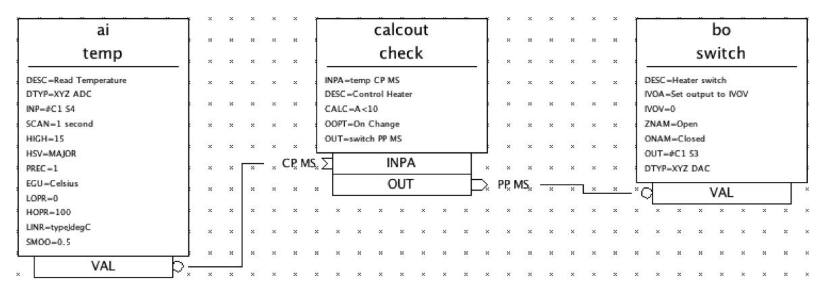
EPICS 'Database’ for Fishtank
Takes getting used to
but handles what we omitted.

Slide 22
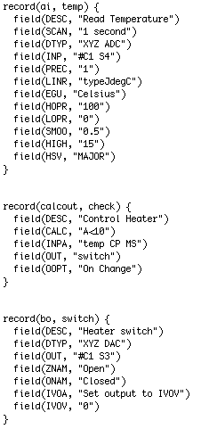
Some Detail on EPICS 'Records'
Programming Configuration
"SCAN=1 second" instead of start thread, delay until next multiple of 1 second, lock required resources, …
"SMOO=0.5" configures the smoothing algorithm.
Almost any field in any record is accessible via network at runtime
  Change scan rate, smoothing, …

Slide 23
IOC Database
A single record can handle the scanning, signal conditioning, alarming of a temperature, pressure, or similar analog reading.
Combined with binary and computational records, it can express the data flow logic for a front-end computer
  Avoiding the pitfalls of real-time, multithreaded and networked programming.
Can have thousands of records in one IOC.
kHz-rate processing with record chains is doable
  Of course limited by CPU. Not 1000nds of kHz rate-records…

Slide 24
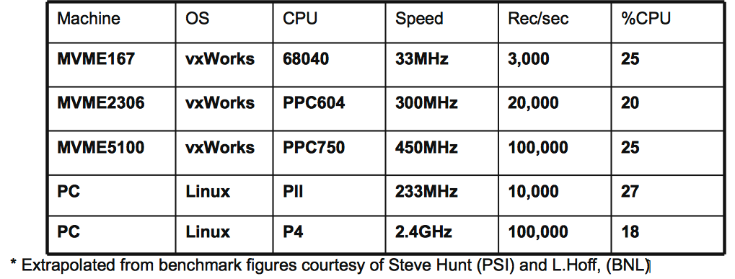
How fast?
Can be fast or slow, it depends how you use it!
Use the correct tool for the job; Database, custom code (IOC) or custom code (client)‏
Ultimately speed depends upon hardware
Some benchmarks*:
2026 Example
SNS MPS IOC
60000 records,
8 CPU cores,
overall average 2%
From Andrew Johnson (APS) EPICS Intro slide

Slide 25
Example Client: Operator Displays
Created in Editor
  No coding,
  no compilation
Networked
  Open/close
  Multiple OPIs

Slide 26
EPICS Vocabulary
EPICS Base
Code for IOC, database support, basic records, channel access
IOC
Input Output Controller, the front-end software
  Hard IOC
  Using real-time OS running nothing but IOC code
  Soft IOC
  IOC software just another process on host,
  typically communicating with networked I/O
Database
Executes the EPICS Records
Record
EPICS processing block
Device support
Code that connects records to hardware Driver
Driver
Code that talks to hardware. May be unaware of EPICS
Channel Access, PV Access
EPICS network protocols. Expose Channels aka Process Variables

Slide 27
Information
https://epics.anl.gov
https://epics-controls.org
  ’Base’
    ‘Record Reference Manual’
      Everybody Must read!
    ‘EPICS Application Developer's Guide’
      Technical detail about ‘makeBaseApp’, build system, device support, C/C++ API
  ’Modules’, ‘H/W by Manufacturer’
    Look there for device support
  ‘Talk’, ‘tech-talk’
    Primary mailing list

Slide 28







EPICS Summary
Control System Toolkit
  Distributed, multi-platform, open source, extensible, …
Not fancy, but “works”
  Accelerators,
  Beam lines,
  Telescopes,
  Fusion experiments,
  …

